Slide 1
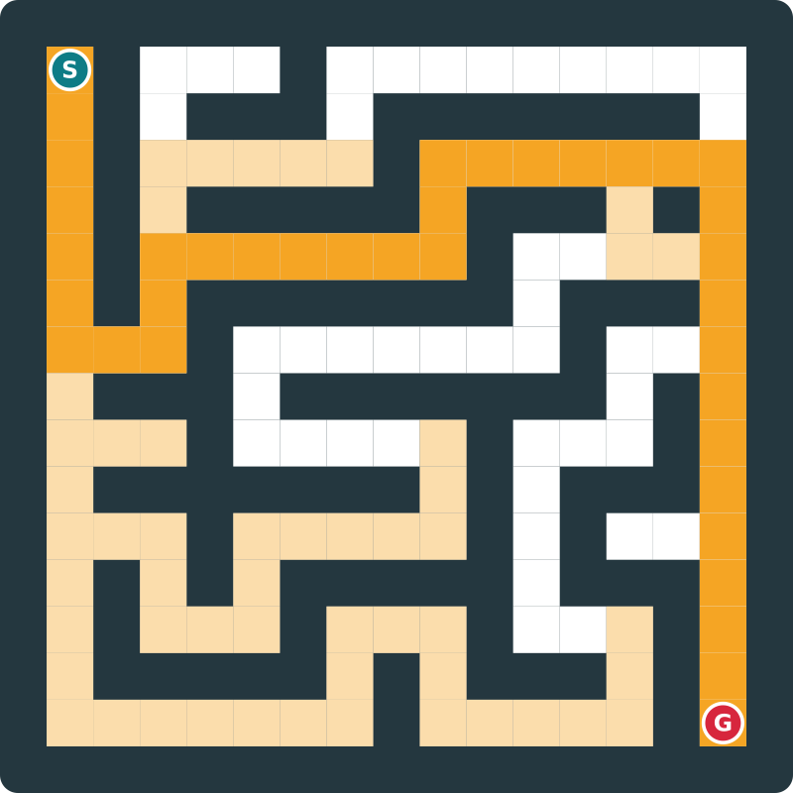
Maze and Path-Finding Optimization System
Design and Analysis of Algorithms | 5th Sem
BFS · DFS · Dijkstra · A*
Group No: 22
Students: Patel Het Chetankumar (12502080603007)
Prabeer kumar Mistry (12502080603014)
Parekh Moksh Jigneshbhai (12502080603012)
Faculty: Yamini Dubey
Notes:
Introduce the group, the course and the project. Fill in the group number, names, enrollment numbers and faculty name on this slide before presenting.

Slide 2
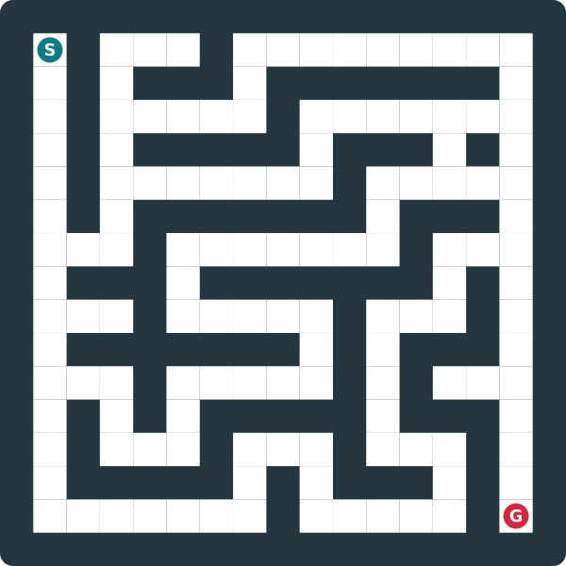




Problem statement
Find an optimal path through a maze from a source to a destination, and compare four algorithms on how well and how efficiently they do it.
Input
Maze grid, source cell, destination cell
Output
Path, path length, execution time, nodes explored
Constraints
4-directional moves, non-negative costs, solvable maze
Objective
Shortest path at lowest cost; rank BFS, DFS, Dijkstra, A*
Example input: source S, destination G
Notes:
State the problem precisely: what goes in, what comes out, the rules, and what we want to achieve. The image shows a sample input maze.

Slide 3

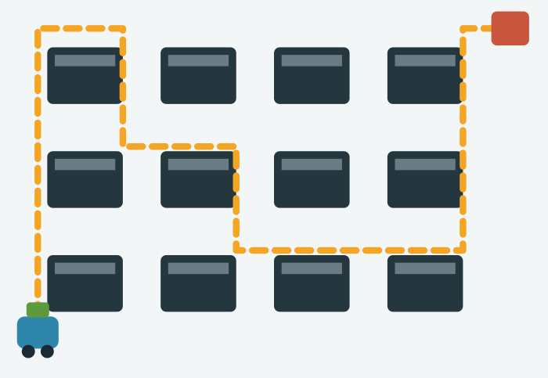
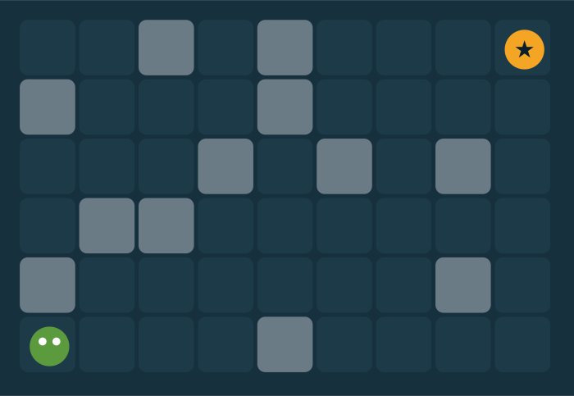
Motivation and real-world use
Why it matters
Where it is used
Who benefits
Efficient routes save time, fuel and computation. The wrong algorithm wastes both.
GPS navigation, game AI, warehouse robots, network routing
Students, game and robotics developers, logistics and mapping teams
Notes:
A maze is the cleanest model of routing problems. The same algorithms power map apps, warehouse robots and game characters finding their way.

Slide 4
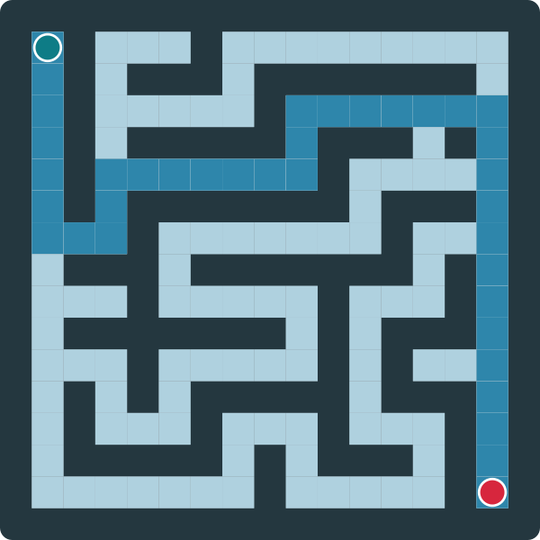
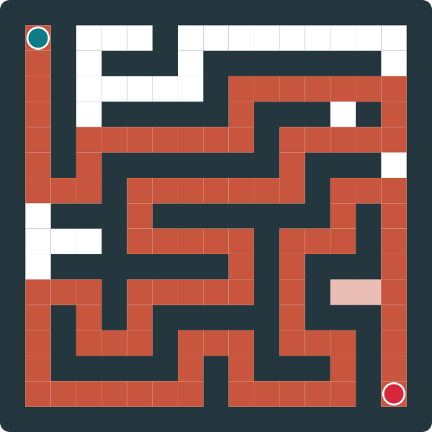
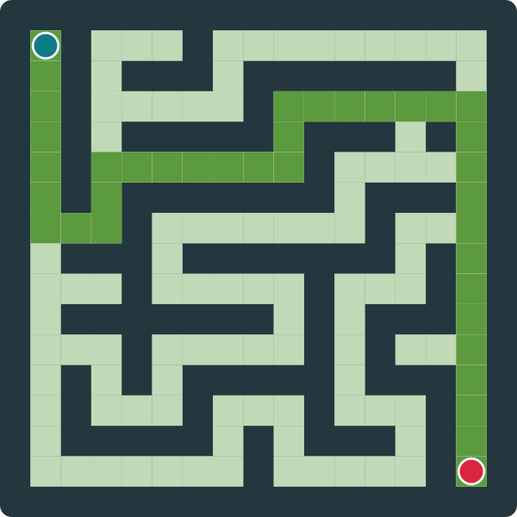

Objectives
1
Implement
BFS, DFS, Dijkstra, A* on one shared grid model
2
Build
Interactive maze with walls, source and destination
3
Measure
BFS
DFS
Path length, time and nodes explored per run
4
Test
Four input sizes: about 10, 50, 100, 500 per side
5
Analyse
Complexity vs observed results
Dijkstra
A*
Notes:
Five measurable objectives. The four mazes on the right are the same input solved by each algorithm: the four implementations we compare.

Slide 5


Existing approach and its limits
Existing approach
Pick one search algorithm (usually BFS or DFS) and trust it for every maze
Limitations
DFS gives long paths. BFS ignores weights and explores everywhere. No side-by-side evidence.
DFS: path of 100 cells
A*: path of 36 cells
Same maze, same source and destination. One algorithm choice changes the path almost threefold.
Need for our approach
Run all four on the same maze and let measured results decide
Notes:
The picture shows the limitation of using one algorithm blindly. DFS finds a path but a very long one, while A star finds the shortest.

Slide 6
Proposed approach: overall flow
1
2
3
4
Problem definition
→
Input / data
→
Algorithm selection
→
Design / pseudocode
Source to destination in a maze
Generate or draw maze; set endpoints
BFS, DFS, Dijkstra, A*
Queue, stack, min-heap, heuristic
↓
8
7
6
5
Results / conclusion
←
Comparison
←
Testing
←
Implementation
Pick the best fit per case
Length, time, nodes explored
Sizes 11 to 501, 4 scenarios
Shared grid model in TypeScript
Notes:
This is the required project flow: define the problem, collect input, select algorithms, design pseudocode, implement, test with different sizes, compare performance, and conclude. Read the first row left to right, then the second row right to left.

Slide 7
Algorithms used
BFS
DFS
Dijkstra
A*
Idea: Explores level by level
Idea: Dives deep, then backtracks
Idea: Expands cheapest node first
Idea: Dijkstra plus goal heuristic
Why: Baseline for shortest path
Why: Fast, low-memory contrast
Why: Optimal on weighted terrain
Why: Optimal, fewer nodes
Data: Queue (FIFO)
Data: Stack (LIFO)
Data: Min-heap on g(n)
Data: Min-heap on g+h
Notes:
Each thumbnail shows the cells that algorithm explored on the same maze. BFS and Dijkstra flood outward, DFS wanders, A star leans toward the goal.

Slide 8
Key pseudocode
BFS
A* (Dijkstra when h = 0)
Q ← queue {source}; mark source
while Q not empty:
u ← dequeue
if u = goal: return path
for each unvisited neighbour v:
mark v; parent[v] ← u
enqueue v
open ← min-heap {source}; g[source] ← 0
while open not empty:
u ← pop least f
if u = goal: return path
for each neighbour v of u:
if g[u] + cost < g[v]:
g[v] ← g[u] + cost; parent[v] ← u
push v with f = g[v] + h(v)
BFS: O(V + E) time, O(V) space
DFS: same loop with a stack
Dijkstra / A*: O((V + E) log V), O(V) space
Notes:
Only the key steps are shown. DFS is the same loop as BFS with a stack instead of a queue. Dijkstra is the A star loop with h equal to zero.

Slide 9



System architecture
User
›
Interface
›
Maze model
›
Algorithm engine
›
Metrics + output
Draws maze, picks source, destination and algorithm
React + Tailwind UI, animated grid
Grid, walls, weights, endpoints
BFS · DFS · Dijkstra · A*
Path, length, time, nodes explored
Results flow back to the interface: the path is highlighted, explored cells are shaded, and the metrics are shown for comparison.
Notes:
The user interacts only with the interface. The maze model is the single source of truth, every algorithm reads it, and the metrics module records the same three values for each run.

Slide 10
Implementation
Tools
Structure | Used for
2D grid array | Maze cells
Queue | BFS frontier
Stack | DFS frontier
Min-heap | Dijkstra, A* frontier
Visited set | Avoid revisits
Parent map | Path rebuild
TypeScript
React 19
Vite
Tailwind CSS 4
motion
lucide-react
Important modules
Maze generator and editor
Four algorithm implementations
Metrics timer and counters
Visualiser and comparison panel
Notes:
The app is a browser-based TypeScript and React project built with Vite. Module names here are descriptive; the table lists the data structure behind each algorithm.

Slide 11
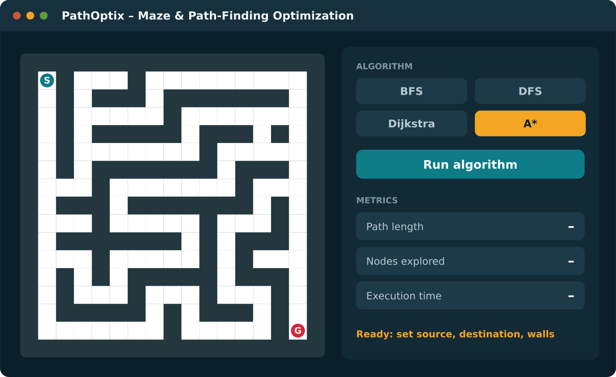
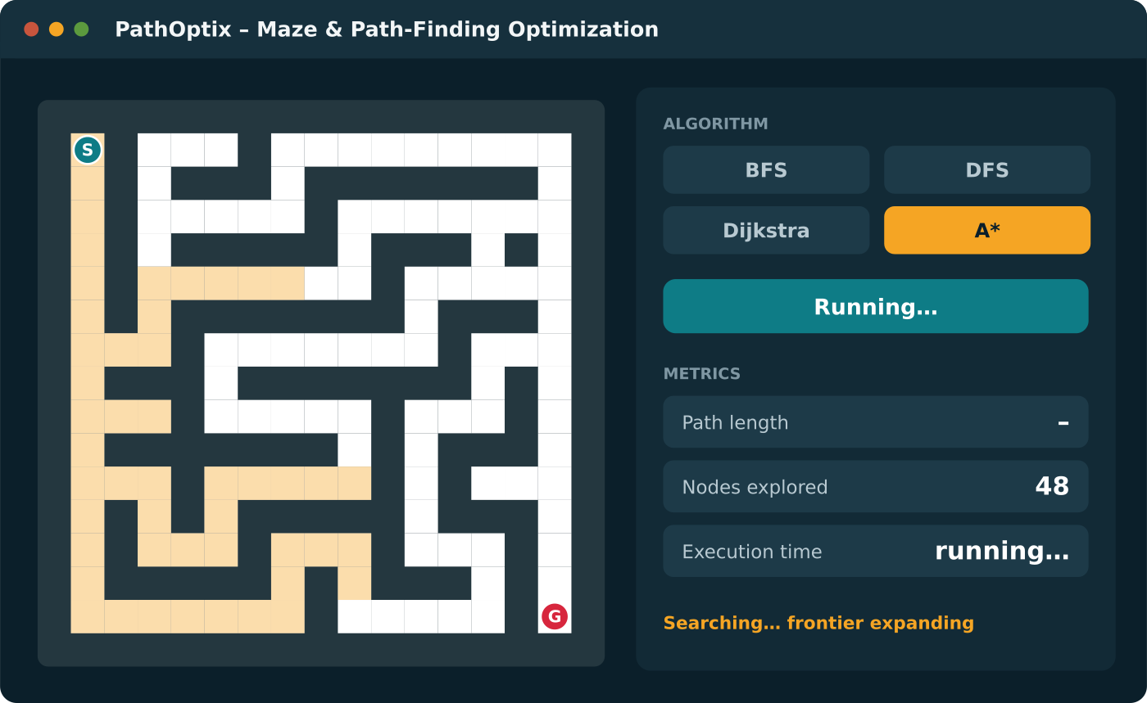
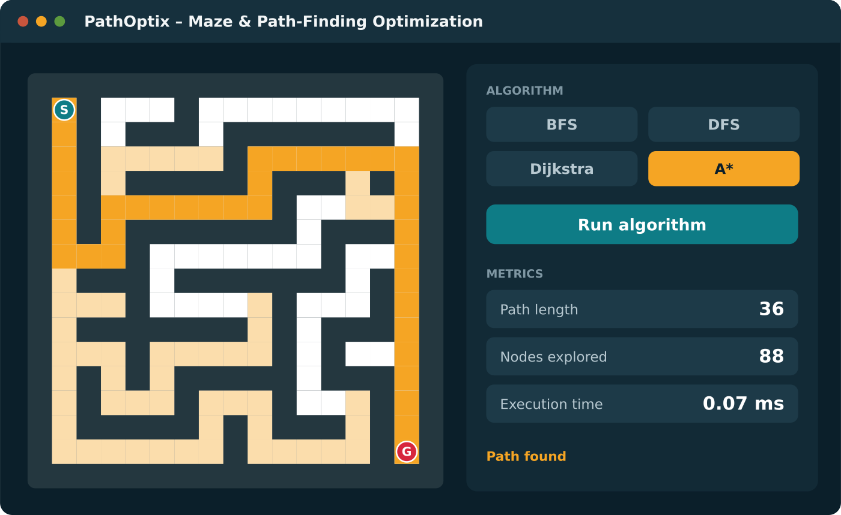
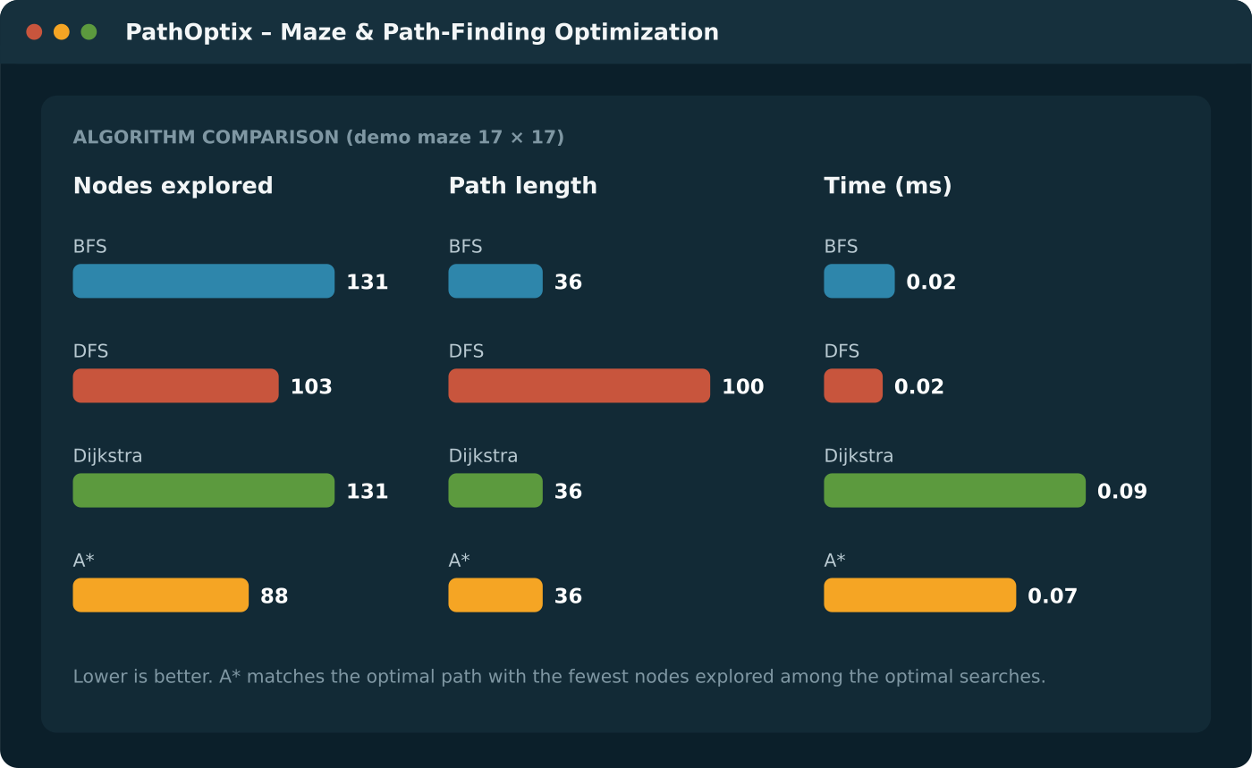
Project screenshots
Input
Processing
Maze with source S and destination G set; A* chosen
A* mid-search: explored cells shaded, count rising
Output
Performance
Final path highlighted with path length, nodes, time
All four algorithms compared on three metrics
Rendered from the algorithm implementation on a 17×17 demo maze. Replace with screenshots of your running app.
Notes:
These four views show the workflow: set the input, watch the search, read the output, compare performance. Swap in real screenshots from the running PathOptix app before presenting if your marking scheme requires your own screenshots.

Slide 12
Results: input size vs time
Average time (ms)
Size | BFS | DFS | Dijkstra | A*
11×11 | 0.05 | 0.07 | 0.06 | 0.03
51×51 | 0.12 | 0.05 | 0.24 | 0.18
101×101 | 0.53 | 0.19 | 1.10 | 0.82
501×501 | 16.82 | 4.18 | 37.55 | 37.02
Dataset: random braided mazes (10% of walls removed), source top-left, destination bottom-right. 100 mazes at 11 and 51, 50 at 101, 10 at 501.
Notes:
Time grows with maze size for every algorithm, and the log scale shows roughly the same shape for all four. DFS is quickest; Dijkstra and A star are slowest per run because of the heap. At 501 by 501, A star no longer beats BFS on time even though it explores fewer nodes.

Slide 13
Complexity analysis
Algorithm | Best | Average | Worst | Space
BFS | O(1) | O(V + E) | O(V + E) | O(V)
DFS | O(1) | O(V + E) | O(V + E) | O(V)
Dijkstra | O(1) | O((V+E) log V) | O((V+E) log V) | O(V)
A* | O(d log V) | Depends on h | O((V+E) log V) | O(V)
Theory vs practice. Best case: goal next to source, or A* with a perfect heuristic (d = path length). Cells grow 96× from 51×51 to 501×501; BFS time grew about 137×, slightly above linear. At 501×501 A* explored 13% fewer nodes than BFS, yet took 2.2× as long: heap overhead outweighs a weak heuristic in mazes.
Notes:
The table gives the theoretical cases. Practical results agree on growth: BFS scales roughly linearly with cells. They also show a constant-factor effect theory hides: priority-queue overhead can cancel the gain from exploring fewer nodes.

Slide 14
Advantages, limitations, future scope
Advantages
Limitations
Future scope
Four algorithms on one shared model
Fair, repeatable metrics
Interactive and visual
Easy to add a new algorithm
Grid and 4-direction moves only
Timings depend on the machine
Manhattan heuristic is weak in mazes
Mazes up to 501×501 tested
Diagonal moves, octile heuristic
Bidirectional search, JPS
Dynamic obstacles
Memory profiling
Notes:
Be honest about limits: the results come from grid mazes and one machine. The natural next steps are diagonal movement, smarter search such as bidirectional and jump point search, and memory measurement.

Slide 15
Conclusion
References
Cormen et al., Introduction to Algorithms (CLRS), MIT Press
Dijkstra, E. W. (1959), A note on two problems in connexion with graphs
Hart, Nilsson, Raphael (1968), A formal basis for the heuristic determination of minimum cost paths
Russell & Norvig, Artificial Intelligence: A Modern Approach
Red Blob Games, Introduction to A*
React, Vite and Tailwind CSS documentation
Test data: randomly generated mazes (own generator)
We compared BFS, DFS, Dijkstra and A* on path length, time and nodes explored.
A* and Dijkstra were optimal in every scenario; A* explored fewer nodes
BFS is the simplest optimal choice on unit-cost mazes
DFS was fastest but returned paths up to ~5× longer
Notes:
Summarise the problem and the solution, then the three findings. Close with references.

